Slide 1

W4111 – 02: Introduction to Databases
Lecture 5: ER Modeling, SQL, Relational (Part 4)
Donald F. Ferguson dff9@Columbia.edu
TRANSCENDING DISCIPLINES, TRANSFORMING LIVES

Slide 2

We will start in a a couple of minutes.
2 | W4111_02_F20: Introduction to Databases -- Lecture 5

Slide 3
Questions
3 | W4111_02_F20: Introduction to Databases -- Lecture 5

Slide 4
Relational Model Continued
4 | W4111_02_F20: Introduction to Databases -- Lecture 5
Notes:
bb

Slide 5

Online Relational Algebra Tool
5 | W4111_02_F20: Introduction to Databases -- Lecture 5

Slide 6
Demos
Online relational tool https://dbis-uibk.github.io/relax/landing
6 | W4111_02_F20: Introduction to Databases – Lecture 2

Slide 7
SQL Continued
7 | W4111_02_F20: Introduction to Databases -- Lecture 5

Slide 8
View
8 | W4111_02_F20: Introduction to Databases -- Lecture 5

Slide 9
Views
In some cases, it is not desirable for all users to see the entire logical model (that is, all the actual relations stored in the database.)
Consider a person who needs to know an instructors name and department, but not the salary. This person should see a relation described, in SQL, by select ID, name, dept_name from instructor
A view provides a mechanism to hide certain data from the view of certain users.
Any relation that is not of the conceptual model but is made visible to a user as a “virtual relation” is called a view.

Slide 10
View Definition
A view is defined using the create view statement which has the form
create view v as < query expression >
where <query expression> is any legal SQL expression. The view name is represented by v.
Once a view is defined, the view name can be used to refer to the virtual relation that the view generates.
View definition is not the same as creating a new relation by evaluating the query expression
Rather, a view definition causes the saving of an expression; the expression is substituted into queries using the view.

Slide 11
View Definition and Use
A view of instructors without their salary
create view faculty as select ID, name, dept_name from instructor
Find all instructors in the Biology department
select name from faculty where dept_name = 'Biology'
Create a view of department salary totals
create view departments_total_salary(dept_name, total_salary) as select dept_name, sum (salary) from instructor group by dept_name;

Slide 12
Views Defined Using Other Views
One view may be used in the expression defining another view
A view relation v₁ is said to depend directly on a view relation v₂ if v₂ is used in the expression defining v₁
A view relation v₁ is said to depend on view relation v₂ if either v₁ depends directly to v₂ or there is a path of dependencies from v₁ to v₂
A view relation v is said to be recursive if it depends on itself.

Slide 13
Views Defined Using Other Views
create view physics_fall_2017 as select course.course_id, sec_id, building, room_number from course, section where course.course_id = section.course_id and course.dept_name = 'Physics' and section.semester = 'Fall' and section.year = '2017’;
create view physics_fall_2017_watson as select course_id, room_number from physics_fall_2017 where building= 'Watson';

Slide 14
View Expansion
Expand the view :
create view physics_fall_2017_watson as select course_id, room_number from physics_fall_2017 where building= 'Watson'
To:
create view physics_fall_2017_watson as
select course_id, room_number
from (select course.course_id, building, room_number
from course, section
where course.course_id = section.course_id
and course.dept_name = 'Physics'
and section.semester = 'Fall'
and section.year = '2017')
where building= 'Watson';

Slide 15
View Expansion (Cont.)
A way to define the meaning of views defined in terms of other views.
Let view v₁ be defined by an expression e₁ that may itself contain uses of view relations.
View expansion of an expression repeats the following replacement step:
repeat Find any view relation v_{i} in e₁ Replace the view relation v_{i} by the expression defining v_{i} until no more view relations are present in e₁
As long as the view definitions are not recursive, this loop will terminate

Slide 16
Materialized Views
Certain database systems allow view relations to be physically stored.
Physical copy created when the view is defined.
Such views are called Materialized view:
If relations used in the query are updated, the materialized view result becomes out of date
Need to maintain the view, by updating the view whenever the underlying relations are updated.

Slide 17
Update of a View
Add a new tuple to faculty view which we defined earlier
insert into faculty
values ('30765', 'Green', 'Music');
This insertion must be represented by the insertion into the instructor relation
Must have a value for salary.
Two approaches
Reject the insert
Inset the tuple
('30765', 'Green', 'Music', null)
into the instructor relation

Slide 18
Some Updates Cannot be Translated Uniquely
create view instructor_info as select ID, name, building from instructor, department where instructor.dept_name= department.dept_name;
insert into instructor_info
values ('69987', 'White', 'Taylor');
Issues
Which department, if multiple departments in Taylor?
What if no department is in Taylor?

Slide 19
And Some Not at All
create view history_instructors as select * from instructor where dept_name= 'History';
What happens if we insert
('25566', 'Brown', 'Biology', 100000)
into history_instructors?

Slide 20
View Updates in SQL
Most SQL implementations allow updates only on simple views
The from clause has only one database relation.
The select clause contains only attribute names of the relation, and does not have any expressions, aggregates, or distinct specification.
Any attribute not listed in the select clause can be set to null
The query does not have a group by or having clause.

Slide 21
Transactions
21 | W4111_02_F20: Introduction to Databases -- Lecture 5

Slide 22
Transactions
A transaction consists of a sequence of query and/or update statements and is a “unit” of work
The SQL standard specifies that a transaction begins implicitly when an SQL statement is executed.
The transaction must end with one of the following statements:
Commit work. The updates performed by the transaction become permanent in the database.
Rollback work. All the updates performed by the SQL statements in the transaction are undone.
Atomic transaction
either fully executed or rolled back as if it never occurred
Isolation from concurrent transactions

Slide 23
Integrity Constraints
23 | W4111_02_F20: Introduction to Databases -- Lecture 5

Slide 24
Integrity Constraints
Integrity constraints guard against accidental damage to the database, by ensuring that authorized changes to the database do not result in a loss of data consistency.
A checking account must have a balance greater than $10,000.00
A salary of a bank employee must be at least $4.00 an hour
A customer must have a (non-null) phone number

Slide 25
Constraints on a Single Relation
not null
primary key
unique
check (P), where P is a predicate

Slide 26
Not Null Constraints
not null
Declare name and budget to be not null
name varchar(20) not null budget numeric(12,2) not null

Slide 27
Unique Constraints
unique ( A₁, A₂, …, A_{m})
The unique specification states that the attributes A₁, A₂, …, A_{m} form a candidate key.
Candidate keys are permitted to be null (in contrast to primary keys).

Slide 28
The check clause
The check (P) clause specifies a predicate P that must be satisfied by every tuple in a relation.
Example: ensure that semester is one of fall, winter, spring or summer
create table section
(course_id varchar (8),
sec_id varchar (8),
semester varchar (6),
year numeric (4,0),
building varchar (15),
room_number varchar (7),
time slot id varchar (4),
primary key (course_id, sec_id, semester, year),
check (semester in ('Fall', 'Winter', 'Spring', 'Summer')))

Slide 29
Referential Integrity
Ensures that a value that appears in one relation for a given set of attributes also appears for a certain set of attributes in another relation.
Example: If “Biology” is a department name appearing in one of the tuples in the instructor relation, then there exists a tuple in the department relation for “Biology”.
Let A be a set of attributes. Let R and S be two relations that contain attributes A and where A is the primary key of S. A is said to be a foreign key of R if for any values of A appearing in R these values also appear in S.

Slide 30
Referential Integrity (Cont.)
Foreign keys can be specified as part of the SQL create table statement
foreign key (dept_name) references department
By default, a foreign key references the primary-key attributes of the referenced table.
SQL allows a list of attributes of the referenced relation to be specified explicitly.
foreign key (dept_name) references department (dept_name)

Slide 31
Cascading Actions in Referential Integrity
When a referential-integrity constraint is violated, the normal procedure is to reject the action that caused the violation.
An alternative, in case of delete or update is to cascade
create table course ( (… dept_name varchar(20), foreign key (dept_name) references department on delete cascade on update cascade, . . .)
Instead of cascade we can use :
set null,
set default

Slide 32
Integrity Constraint Violation During Transactions
Consider:
create table person ( ID char(10), name char(40), mother char(10), father char(10), primary key ID, foreign key father references person, foreign key mother references person)
How to insert a tuple without causing constraint violation?
Insert father and mother of a person before inserting person
OR, set father and mother to null initially, update after inserting all persons (not possible if father and mother attributes declared to be not null)
OR defer constraint checking

Slide 33
Complex Check Conditions
The predicate in the check clause can be an arbitrary predicate that can include a subquery.
check (time_slot_id in (select time_slot_id from time_slot))
The check condition states that the time_slot_id in each tuple in the section relation is actually the identifier of a time slot in the time_slot relation.
The condition has to be checked not only when a tuple is inserted or modified in section , but also when the relation time_slot changes

Slide 34
Assertions
An assertion is a predicate expressing a condition that we wish the database always to satisfy.
The following constraints, can be expressed using assertions:
For each tuple in the student relation, the value of the attribute tot_cred must equal the sum of credits of courses that the student has completed successfully.
An instructor cannot teach in two different classrooms in a semester in the same time slot
An assertion in SQL takes the form:
create assertion <assertion-name> check (<predicate>);

Slide 35
Built-in Data Types in SQL
date: Dates, containing a (4 digit) year, month and date
Example: date '2005-7-27'
time: Time of day, in hours, minutes and seconds.
Example: time '09:00:30' time '09:00:30.75'
timestamp: date plus time of day
Example: timestamp '2005-7-27 09:00:30.75'
interval: period of time
Example: interval '1' day
Subtracting a date/time/timestamp value from another gives an interval value
Interval values can be added to date/time/timestamp values

Slide 36
Large-Object Types
Large objects (photos, videos, CAD files, etc.) are stored as a large object:
blob: binary large object -- object is a large collection of uninterpreted binary data (whose interpretation is left to an application outside of the database system)
clob: character large object -- object is a large collection of character data
When a query returns a large object, a pointer is returned rather than the large object itself.

Slide 37
User-Defined Types
create type construct in SQL creates user-defined type
create type Dollars as numeric (12,2) final
Example:
create table department (dept_name varchar (20), building varchar (15), budget Dollars);

Slide 38
Domains
create domain construct in SQL-92 creates user-defined domain types
create domain person_name char(20) not null
Types and domains are similar. Domains can have constraints, such as not null, specified on them.
Example:
create domain degree_level varchar(10) constraint degree_level_test check (value in ('Bachelors', 'Masters', 'Doctorate'));

Slide 39
Indexes
39 | W4111_02_F20: Introduction to Databases -- Lecture 5

Slide 40
Index Creation
Many queries reference only a small proportion of the records in a table.
It is inefficient for the system to read every record to find a record with particular value
An index on an attribute of a relation is a data structure that allows the database system to find those tuples in the relation that have a specified value for that attribute efficiently, without scanning through all the tuples of the relation.
We create an index with the create index command
create index <name> on <relation-name> (attribute);

Slide 41
Index Creation Example
create table student (ID varchar (5), name varchar (20) not null, dept_name varchar (20), tot_cred numeric (3,0) default 0, primary key (ID))
create index studentID_index on student(ID)
The query:
select * from student where ID = '12345'
can be executed by using the index to find the required record, without looking at all records of student

Slide 42
Authorization
42 | W4111_02_F20: Introduction to Databases -- Lecture 5

Slide 43
Authorization
We may assign a user several forms of authorizations on parts of the database.
Read - allows reading, but not modification of data.
Insert - allows insertion of new data, but not modification of existing data.
Update - allows modification, but not deletion of data.
Delete - allows deletion of data.
Each of these types of authorizations is called a privilege. We may authorize the user all, none, or a combination of these types of privileges on specified parts of a database, such as a relation or a view.

Slide 44
Authorization (Cont.)
Forms of authorization to modify the database schema
Index - allows creation and deletion of indices.
Resources - allows creation of new relations.
Alteration - allows addition or deletion of attributes in a relation.
Drop - allows deletion of relations.

Slide 45
Authorization Specification in SQL
The grant statement is used to confer authorization
grant <privilege list> on <relation or view > to <user list>
<user list> is:
a user-id
public, which allows all valid users the privilege granted
A role (more on this later)
Example:
grant select on department to Amit, Satoshi
Granting a privilege on a view does not imply granting any privileges on the underlying relations.
The grantor of the privilege must already hold the privilege on the specified item (or be the database administrator).

Slide 46
Privileges in SQL
select: allows read access to relation, or the ability to query using the view
Example: grant users U₁, U₂, and U₃ select authorization on the instructor relation:
grant select on instructor to U₁, U₂, U₃
insert: the ability to insert tuples
update: the ability to update using the SQL update statement
delete: the ability to delete tuples.
all privileges: used as a short form for all the allowable privileges

Slide 47
Revoking Authorization in SQL
The revoke statement is used to revoke authorization.
revoke <privilege list> on <relation or view> from <user list>
Example:
revoke select on student from U₁, U₂, U₃
<privilege-list> may be all to revoke all privileges the revokee may hold.
If <revokee-list> includes public, all users lose the privilege except those granted it explicitly.
If the same privilege was granted twice to the same user by different grantees, the user may retain the privilege after the revocation.
All privileges that depend on the privilege being revoked are also revoked.

Slide 48
Roles
A role is a way to distinguish among various users as far as what these users can access/update in the database.
To create a role we use:
create a role <name>
Example:
create role instructor
Once a role is created we can assign “users” to the role using:
grant <role> to <users>

Slide 49
Roles Example
create role instructor;
grant instructor to Amit;
Privileges can be granted to roles:
grant select on takes to instructor;
Roles can be granted to users, as well as to other roles
create role teaching_assistant
grant teaching_assistant to instructor;
Instructor inherits all privileges of teaching_assistant
Chain of roles
create role dean;
grant instructor to dean;
grant dean to Satoshi;

Slide 50
Authorization on Views
create view geo_instructor as (select * from instructor where dept_name = 'Geology');
grant select on geo_instructor to geo_staff
Suppose that a geo_staff member issues
select * from geo_instructor;
What if
geo_staff does not have permissions on instructor?
Creator of view did not have some permissions on instructor?

Slide 51
Other Authorization Features
references privilege to create foreign key
grant reference (dept_name) on department to Mariano;
Why is this required?
transfer of privileges
grant select on department to Amit with grant option;
revoke select on department from Amit, Satoshi cascade;
revoke select on department from Amit, Satoshi restrict;
And more!

Slide 52
Fun with Joins
52 | W4111_02_F20: Introduction to Databases -- Lecture 5

Slide 53
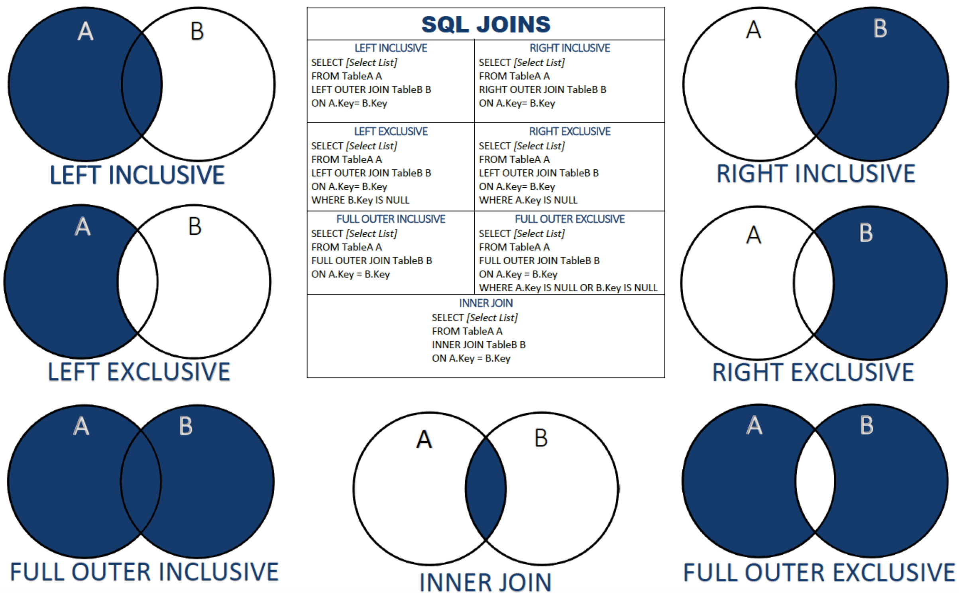
One Way to Think About JOINs
53 | W4111_02_F20: Introduction to Databases – Lecture 4

Slide 54
We Will Use Classic Models and Lahman 2019
Classic Models
54 | W4111_02_F20: Introduction to Databases -- Lecture 5

Slide 55
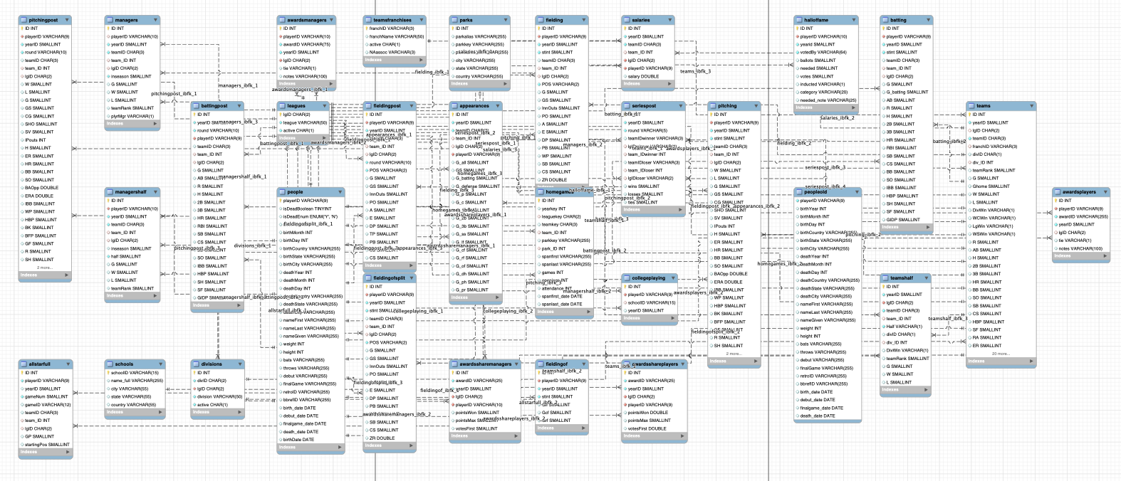
We Will Use Classic Models and Lahman 2019
Lahaman 2019 Database – Cleaned Up
55 | W4111_02_F20: Introduction to Databases -- Lecture 5

Slide 56
Fun with JOINs
56 | W4111_02_F20: Introduction to Databases -- Lecture 5

Slide 57
Functions, Procedures, Triggers
57 | W4111_02_F20: Introduction to Databases -- Lecture 5

Slide 58
Functions and Procedures

Slide 59
Functions and Procedures
Functions and procedures allow “business logic” to be stored in the database and executed from SQL statements.
These can be defined either by the procedural component of SQL or by an external programming language such as Java, C, or C++.
The syntax we present here is defined by the SQL standard.
Most databases implement nonstandard versions of this syntax.

Slide 60
Declaring SQL Functions
Define a function that, given the name of a department, returns the count of the number of instructors in that department.
create function dept_count (dept_name varchar(20)) returns integer begin declare d_count integer; select count (* ) into d_count from instructor where instructor.dept_name = dept_name return d_count; end
The function dept_count can be used to find the department names and budget of all departments with more that 12 instructors.
select dept_name, budget from department where dept_count (dept_name ) > 12

Slide 61
Table Functions
The SQL standard supports functions that can return tables as results; such functions are called table functions
Example: Return all instructors in a given department
create function instructor_of (dept_name char(20))
returns table (
ID varchar(5), name varchar(20), dept_name varchar(20), salary numeric(8,2))
return table (select ID, name, dept_name, salary from instructor where instructor.dept_name = instructor_of.dept_name)
Usage
select * from table (instructor_of ('Music'))

Slide 62
SQL Procedures
The dept_count function could instead be written as procedure:
create procedure dept_count_proc (in dept_name varchar(20), out d_count integer) begin
select count(*) into d_count from instructor where instructor.dept_name = dept_count_proc.dept_name
end
The keywords in and out are parameters that are expected to have values assigned to them and parameters whose values are set in the procedure in order to return results.
Procedures can be invoked either from an SQL procedure or from embedded SQL, using the call statement.
declare d_count integer; call dept_count_proc( 'Physics', d_count);

Slide 63
SQL Procedures (Cont.)
Procedures and functions can be invoked also from dynamic SQL
SQL allows more than one procedure of the so long as the number of arguments of the procedures with the same name is different.
The name, along with the number of arguments, is used to identify the procedure.

Slide 64
Language Constructs for Procedures & Functions
SQL supports constructs that gives it almost all the power of a general-purpose programming language.
Warning: most database systems implement their own variant of the standard syntax below.
Compound statement: begin … end,
May contain multiple SQL statements between begin and end.
Local variables can be declared within a compound statements
While and repeat statements:
while boolean expression do
sequence of statements ;
end while
repeat
sequence of statements ;
until boolean expression
end repeat

Slide 65
Language Constructs (Cont.)
For loop
Permits iteration over all results of a query
Example: Find the budget of all departments declare n integer default 0; for r as select budget from department where dept_name = 'Music' do set n = n + r.budget end for

Slide 66
Language Constructs – if-then-else
Conditional statements (if-then-else)
if boolean expression then statement or compound statement elseif boolean expression then statement or compound statement else statement or compound statement end if

Slide 67
Example procedure
Registers student after ensuring classroom capacity is not exceeded
Returns 0 on success and -1 if capacity is exceeded
See book (page 202) for details
Signaling of exception conditions, and declaring handlers for exceptions
declare out_of_classroom_seats condition declare exit handler for out_of_classroom_seats begin … end
The statements between the begin and the end can raise an exception by executing “signal out_of_classroom_seats”
The handler says that if the condition arises he action to be taken is to exit the enclosing the begin end statement.

Slide 68
External Language Routines
SQL allows us to define functions in a programming language such as Java, C#, C or C++.
Can be more efficient than functions defined in SQL, and computations that cannot be carried out in SQL\can be executed by these functions.
Declaring external language procedures and functions
create procedure dept_count_proc(in dept_name varchar(20), out count integer) language C external name '/usr/avi/bin/dept_count_proc' create function dept_count(dept_name varchar(20)) returns integer language C external name '/usr/avi/bin/dept_count'

Slide 69
External Language Routines (Cont.)
Benefits of external language functions/procedures:
more efficient for many operations, and more expressive power.
Drawbacks
Code to implement function may need to be loaded into database system and executed in the database system’s address space.
risk of accidental corruption of database structures
security risk, allowing users access to unauthorized data
There are alternatives, which give good security at the cost of potentially worse performance.
Direct execution in the database system’s space is used when efficiency is more important than security.

Slide 70
Security with External Language Routines
To deal with security problems, we can do on of the following:
Use sandbox techniques
That is, use a safe language like Java, which cannot be used to access/damage other parts of the database code.
Run external language functions/procedures in a separate process, with no access to the database process’ memory.
Parameters and results communicated via inter-process communication
Both have performance overheads
Many database systems support both above approaches as well as direct executing in database system address space.

Slide 71
Triggers

Slide 72
Triggers
A trigger is a statement that is executed automatically by the system as a side effect of a modification to the database.
To design a trigger mechanism, we must:
Specify the conditions under which the trigger is to be executed.
Specify the actions to be taken when the trigger executes.
Triggers introduced to SQL standard in SQL:1999, but supported even earlier using non-standard syntax by most databases.
Syntax illustrated here may not work exactly on your database system; check the system manuals

Slide 73
Triggering Events and Actions in SQL
Triggering event can be insert, delete or update
Triggers on update can be restricted to specific attributes
For example, after update of takes on grade
Values of attributes before and after an update can be referenced
referencing old row as : for deletes and updates
referencing new row as : for inserts and updates
Triggers can be activated before an event, which can serve as extra constraints. For example, convert blank grades to null.
create trigger setnull_trigger before update of takes referencing new row as nrow for each row when (nrow.grade = ' ') begin atomic set nrow.grade = null; end;

Slide 74
Trigger to Maintain credits_earned value
create trigger credits_earned after update of takes on (grade) referencing new row as nrow referencing old row as orow for each row when nrow.grade <> 'F' and nrow.grade is not null and (orow.grade = 'F' or orow.grade is null) begin atomic update student set tot_cred= tot_cred + (select credits from course where course.course_id= nrow.course_id) where student.id = nrow.id; end;

Slide 75
Statement Level Triggers
Instead of executing a separate action for each affected row, a single action can be executed for all rows affected by a transaction
Use for each statement instead of for each row
Use referencing old table or referencing new table to refer to temporary tables (called transition tables) containing the affected rows
Can be more efficient when dealing with SQL statements that update a large number of rows

Slide 76
When Not To Use Triggers
Triggers were used earlier for tasks such as
Maintaining summary data (e.g., total salary of each department)
Replicating databases by recording changes to special relations (called change or delta relations) and having a separate process that applies the changes over to a replica
There are better ways of doing these now:
Databases today provide built in materialized view facilities to maintain summary data
Databases provide built-in support for replication
Encapsulation facilities can be used instead of triggers in many cases
Define methods to update fields
Carry out actions as part of the update methods instead of through a trigger

Slide 77
When Not To Use Triggers (Cont.)
Risk of unintended execution of triggers, for example, when
Loading data from a backup copy
Replicating updates at a remote site
Trigger execution can be disabled before such actions.
Other risks with triggers:
Error leading to failure of critical transactions that set off the trigger
Cascading execution

Slide 78
Recursive Queries

Slide 79
Recursion in SQL
SQL:1999 permits recursive view definition
Example: find which courses are a prerequisite, whether directly or indirectly, for a specific course with recursive rec_prereq(course_id, prereq_id) as ( select course_id, prereq_id from prereq union select rec_prereq.course_id, prereq.prereq_id, from rec_rereq, prereq where rec_prereq.prereq_id = prereq.course_id ) select ∗ from rec_prereq;
This example view, rec_prereq, is called the transitive closure of the prereq relation

Slide 80
The Power of Recursion
Recursive views make it possible to write queries, such as transitive closure queries, that cannot be written without recursion or iteration.
Intuition: Without recursion, a non-recursive non-iterative program can perform only a fixed number of joins of prereq with itself
This can give only a fixed number of levels of managers
Given a fixed non-recursive query, we can construct a database with a greater number of levels of prerequisites on which the query will not work
Alternative: write a procedure to iterate as many times as required
See procedure findAllPrereqs in book

Slide 81
The Power of Recursion
Computing transitive closure using iteration, adding successive tuples to rec_prereq
The next slide shows a prereq relation
Each step of the iterative process constructs an extended version of rec_prereq from its recursive definition.
The final result is called the fixed point of the recursive view definition.
Recursive views are required to be monotonic. That is, if we add tuples to prereq the view rec_prereq contains all of the tuples it contained before, plus possibly more

Slide 82
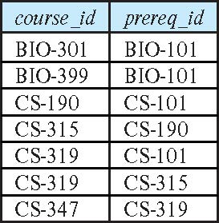
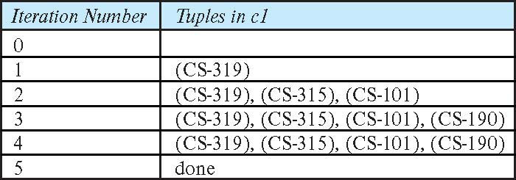
Example of Fixed-Point Computation

Slide 83
Entity-Relationship Model (Continued)
83 | W4111_02_F20: Introduction to Databases -- Lecture 5

Slide 84
Weak Entity Sets
Consider a section entity, which is uniquely identified by a course_id, semester, year, and sec_id.
Clearly, section entities are related to course entities. Suppose we create a relationship set sec_course between entity sets section and course.
Note that the information in sec_course is redundant, since section already has an attribute course_id, which identifies the course with which the section is related.
One option to deal with this redundancy is to get rid of the relationship sec_course; however, by doing so the relationship between section and course becomes implicit in an attribute, which is not desirable.

Slide 85
Weak Entity Sets (Cont.)
An alternative way to deal with this redundancy is to not store the attribute course_id in the section entity and to only store the remaining attributes section_id, year, and semester.
However, the entity set section then does not have enough attributes to identify a particular section entity uniquely
To deal with this problem, we treat the relationship sec_course as a special relationship that provides extra information, in this case, the course_id, required to identify section entities uniquely.
A weak entity set is one whose existence is dependent on another entity, called its identifying entity
Instead of associating a primary key with a weak entity, we use the identifying entity, along with extra attributes called discriminator to uniquely identify a weak entity.

Slide 86
Weak Entity Sets (Cont.)
An entity set that is not a weak entity set is termed a strong entity set.
Every weak entity must be associated with an identifying entity; that is, the weak entity set is said to be existence dependent on the identifying entity set.
The identifying entity set is said to own the weak entity set that it identifies.
The relationship associating the weak entity set with the identifying entity set is called the identifying relationship.
Note that the relational schema we eventually create from the entity set section does have the attribute course_id, for reasons that will become clear later, even though we have dropped the attribute course_id from the entity set section.

Slide 87
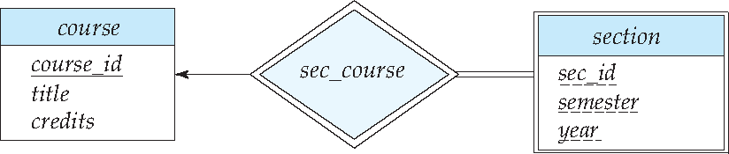
Expressing Weak Entity Sets
In E-R diagrams, a weak entity set is depicted via a double rectangle.
We underline the discriminator of a weak entity set with a dashed line.
The relationship set connecting the weak entity set to the identifying strong entity set is depicted by a double diamond.
Primary key for section – (course_id, sec_id, semester, year)

Slide 88
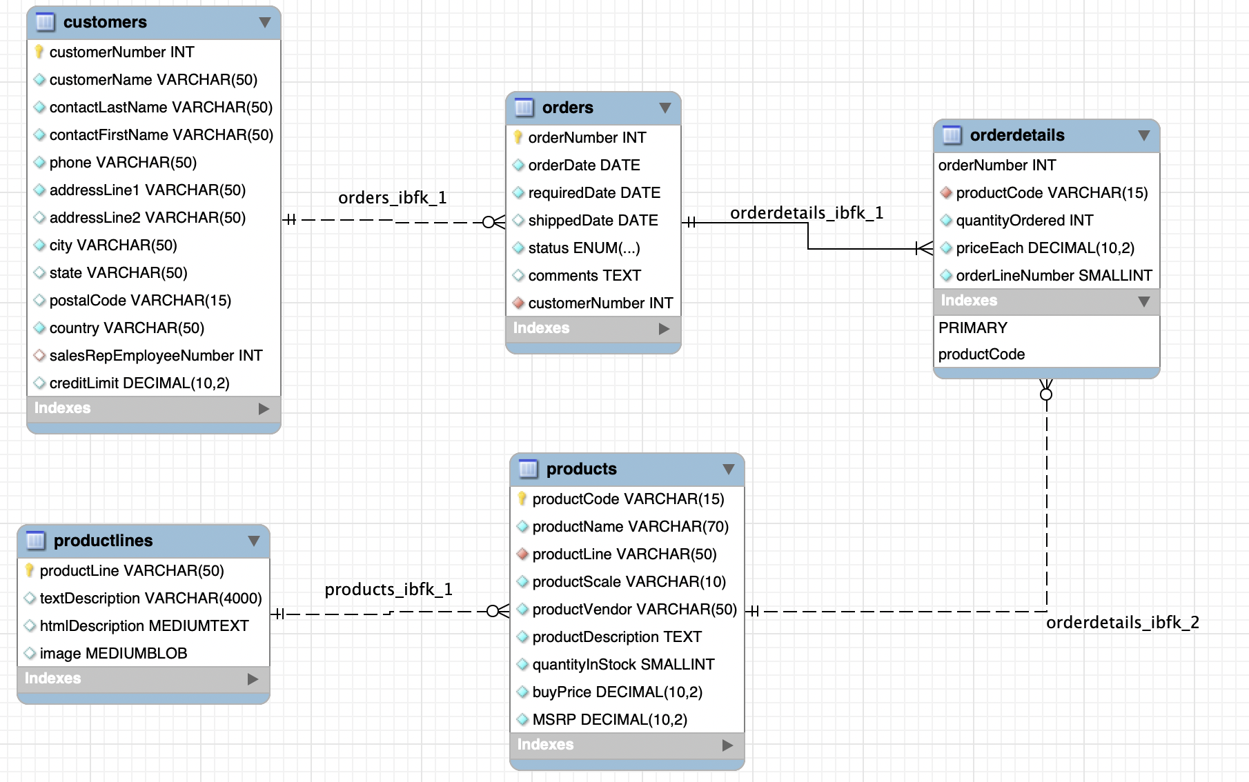
An Example – Classic Models
https://www.mysqltutorial.org/mysql-sample-database.aspx/
88 | W4111_02_F20: Introduction to Databases – Lecture 4

Slide 89
Customer ID: 201
OrderNo: 31
OrderedDate:504
ProductID | Quantity | Price | OrderID
111 | 2 | 2.10 | 31
101 | 11 | 1.30 | 31
333 | 102 | 47.5 | 31
Orders
LineItems

Slide 90
Let’s Do Some Worked Examples
90 | W4111_02_F20: Introduction to Databases -- Lecture 5

Slide 91
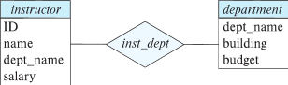
Redundant Attributes
Suppose we have entity sets:
instructor, with attributes: ID, name, dept_name, salary
department, with attributes: dept_name, building, budget
We model the fact that each instructor has an associated department using a relationship set inst_dept
The attribute dept_name in instructor replicates information present in the relationship and is therefore redundant
and needs to be removed.
BUT: when converting back to tables, in some cases the attribute gets reintroduced, as we will see later.

Slide 92
An Example – Redundant Attributes
Let’s see an example.
92 | W4111_02_F20: Introduction to Databases – Lecture 2

Slide 93
Design Alternatives
In designing a database schema, we must ensure that we avoid two major pitfalls:
Redundancy: a bad design may result in repeat information.
Redundant representation of information may lead to data inconsistency among the various copies of information
Incompleteness: a bad design may make certain aspects of the enterprise difficult or impossible to model.
Avoiding bad designs is not enough. There may be a large number of good designs from which we must choose.
Emphasis Added
Notes:
93

Slide 94
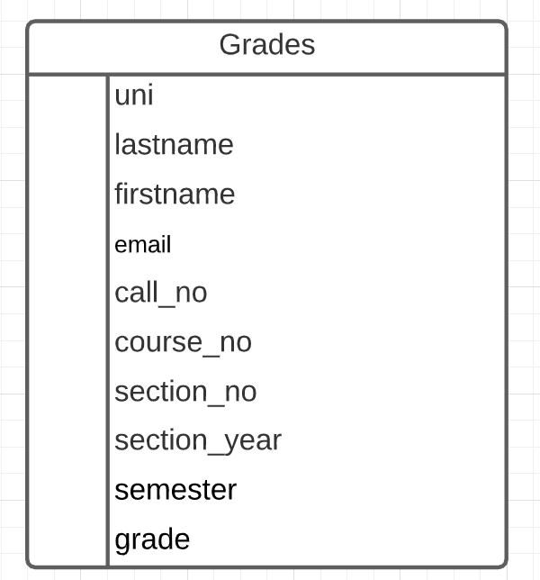
What is an Example?
Consider the Grades table/relation:
Uni identifies student.
lastname, firstname, email have obvious meaning.
call_no, course_no, section_no, semester, section_year, grade have the obvious meanings relative to Columbia course info.
Let’s focus on redundant information problems:
Inside the table:
(uni, lastname, firstname, email)
(call_no, course_no, section_no, section_year, semester)
Between tables: Presumable there are other tables with information on
Course descriptions and sections.
Course enrollments.
Additional student information.
This is easier if we make some data and show how we can “break it.”
94 | W4111_02_S20: Introduction to Databases -- Lecture 3,4

